Slide 1

Assigning Households
Interviewer (sender) >> Bluetooth >> Interviewer (receiver)

Slide 2
Fieldwork Flow – Assign HHs
Arrive in cluster, Identify households
Interviewers carry out individual interviews, enter biomarker data
Supervisor assigns households to interviewers
Interviewers send data to supervisor
Interviewers interview HHs, identify eligible individuals
Team resolves structural problems
Interviewers send data to supervisor
Supervisor carries out remeasurement
Health techs collect height/weight, anemia Vitamin A
Supervisor submits data to central office

Slide 3
Assigning Households: What? Why? When? Who? How?
What?
Why?
When?
Who?
How?
Assigning households to each of the interviewers
Manage and track workload among team properly
Before work can begin in a cluster, the households must be assigned
Supervisors assign households to be completed by interviewers
Supervisor assigns, sends to interviewers over Bluetooth

Slide 4




Steps in assigning households
Supervisor assigns households on their tablet
Interviewers prepare to receive household assignment; supervisors prepare to send
Supervisors send household assignment
Interviewers confirm assignment on their tablets

Slide 5
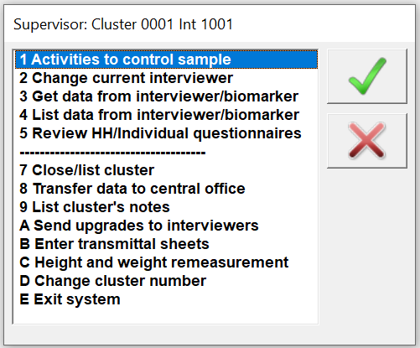
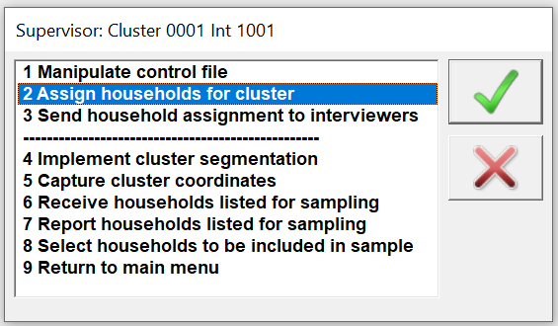
Supervisor Assigns Households
From supervisor main menu, choose the following:
Assignment uses file Household Selected in Cluster

Slide 6
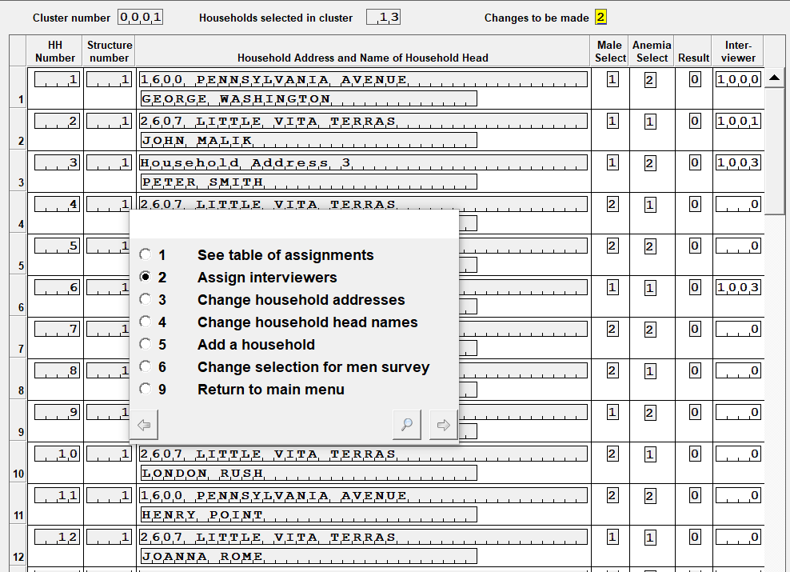
Supervisor Assigns Households
Household Assignment Listing:
Notes:
Note:
Cluster number must be correct; number of households in cluster depends on sample
Household numbers, Building numbers (structure), Addresses, Names, Result code, and currently assigned interviewer.
If interviewer should change, that can be done.

Slide 7
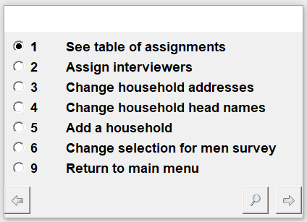
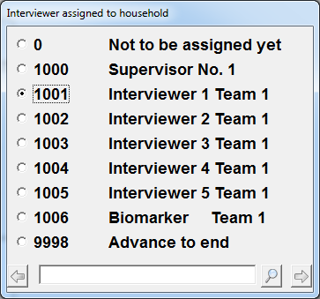
Supervisor Assigns Households
Choose option 2 to assign households to interviewers:
Choose interviewer for each household:
Finished for now? Choose 9998 to exit
Skip a household? Choose 0 to move on

Slide 8
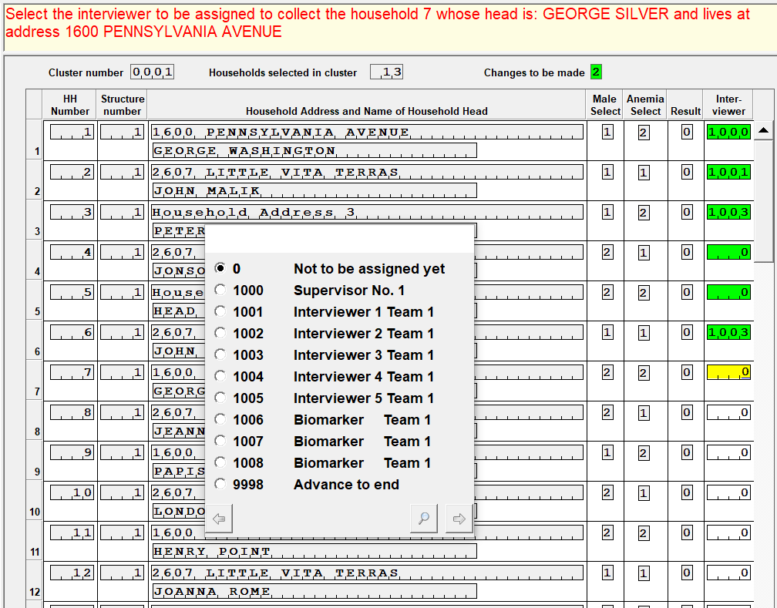
Supervisor Assigns Households
Notes:
Which households were skipped for now?
Which household does Interviewer 1 have?
When done, choosing 9998 closes the household assignment and returns the system to the main menu

Slide 9
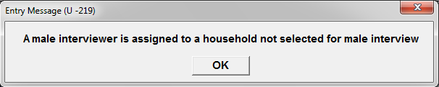
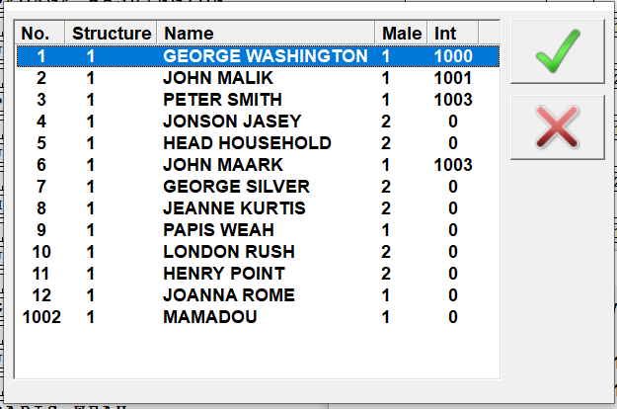
Supervisor Assigns Households
If a male is assigned to a house not selected:
When finished, review the assignment:
Notes:
If we put a male interviewer on a house not selected, is that a problem?
They can do household but will not be able to do anymore work…. So, ok, but not ideal.

Slide 10
Video and discussion
.
Demonstration of Household Assignment in Supervisor Menu
Notes:
Make sure all teams know their cluster number!

Slide 11

Bluetooth Data Transfer
Bluetooth is a wireless option for sharing data over a short distance
DHS uses Bluetooth to transfer data within each team
Each tablet has Bluetooth built in
Used for assigning households, submitting data to supervisor, sharing households
Sender and receiver in each transfer

Slide 12
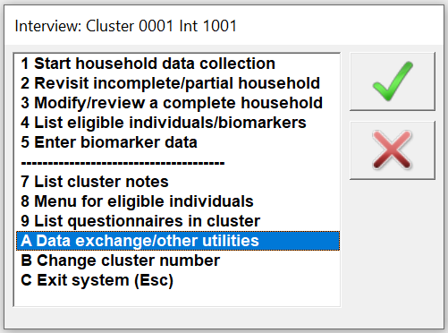
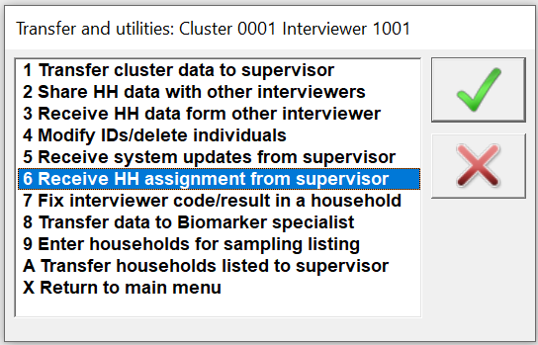
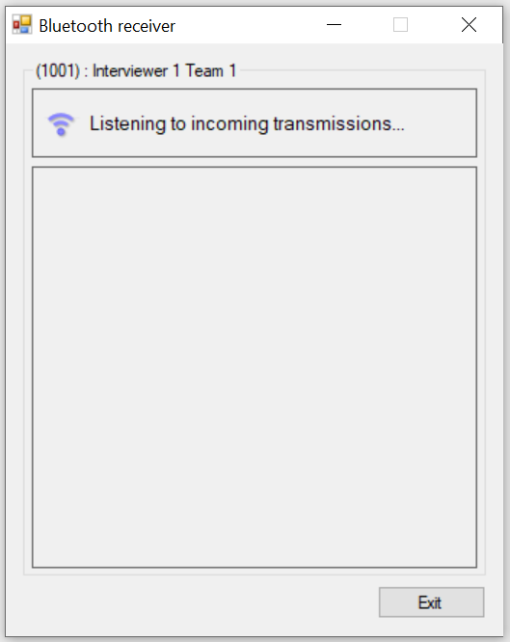
Interviewers prepare to receive
From interviewer main menu, choose the following:
System begins searching for Bluetooth connection – interviewers tell supervisors they are ready…

Slide 13
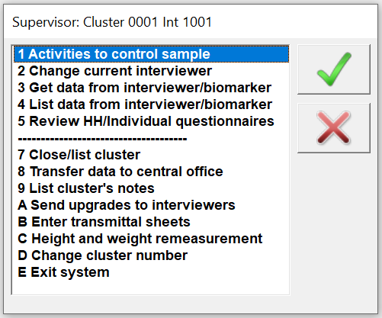
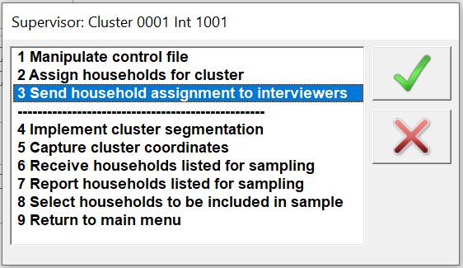
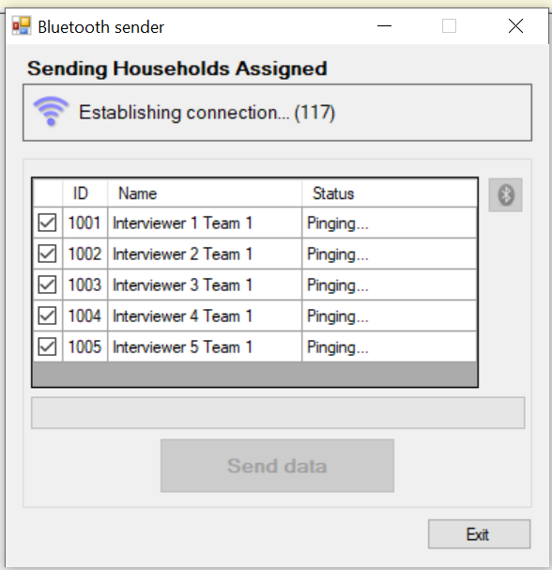
Supervisors prepare to send
From supervisor main menu, choose the following:
System begins searching for Bluetooth connection with all interviewers, regardless of whether they are receiving

Slide 14
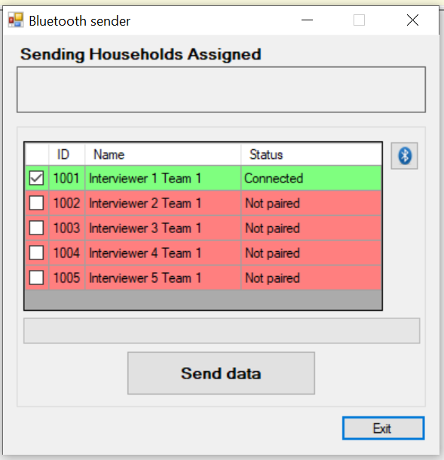
Supervisors send assignments
Each green interviewer is connected; each red interviewer is not connected/not paired:
Click Send data when ready
(all interviewers are green or red)
Supervisor may try to pair with more interviewers, or may send data to connected interviewers (and then retry whole process again)
When successful, both interviewer and supervisor Bluetooth windows will close
Notes:
What three possible reasons are there for not pairing?
Answer – interviewers are not trying to receive assignment; or Bluetooth did not make connection (so troubleshoot – check if it’s on, or try again); or interviewer was not listening/prepared to receive when supervisor started sending.

Slide 15
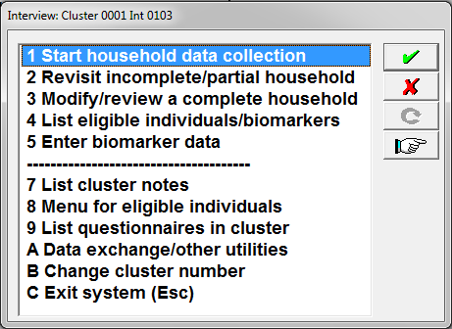
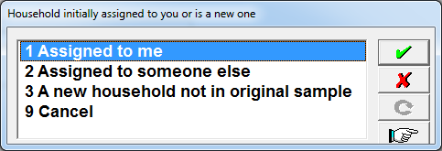
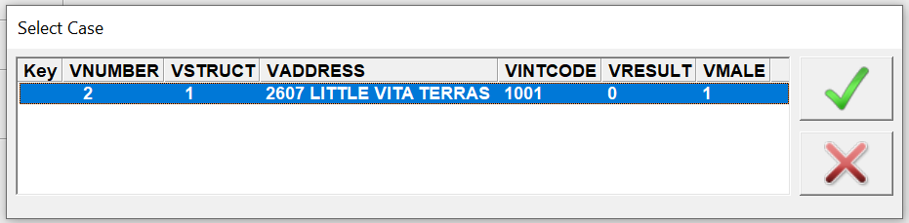
Interviewers confirm assignment
From interviewer main menu, choose the following:
Confirm all households assigned are listed. If so, SUCCESS!! SUCCESS!!

Slide 16
Video and discussion
.
Video on transfer of assignments
Notes:
Make sure all teams know their cluster number!

Slide 17

Practice time!
Supervisors should assign ONE household per interviewer (include self!) for their first cluster.
Cluster 0002
Go for it!
Notes:
Make sure all teams know their cluster number!

